Slide 1
Python Introduction in Hindi
-by Dataverse Tutorials

Slide 2
Python Introduction
Python is a high-level programming language
Created in 1991
Focuses on simplicity and readability
Uses fewer lines of code
Beginner-friendly language

Slide 3
History of Python
Python was created in 1991
Designed with code readability in mind
Focus on developer productivity
Easy to learn and use

Slide 4
Features of Python
Dynamic typing (no need to declare data types)
Multiple programming paradigms supported
Object-Oriented Programming
Functional Programming
Procedural Programming

Slide 5

Hello World Program in Python
First basic Python program
Displays output on screen
Uses built-in print() function

Slide 6
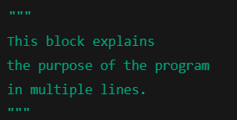
Comments in Python
Used to explain code
Ignored by Python interpreter
Improves code readability

Slide 7

Indentation in Python
Defines code blocks
Mandatory in Python
Uses spaces or tabs
Recommended: 4 spaces

Slide 8
Key Takeaways
Python is simple and powerful
Beginner-friendly language
Indentation is mandatory
Comments improve readability

Slide 9


